Slide 1
GONE PHISHIN’
Sean Patterson
Victoria Manchester
Serena Buxton
Peter Borrell
Ziheng Zhu
Notes:
Sean- Introduction
Everyone says their name in introduction

Slide 2
Intro
Gone Phishin’ is a phishing app meant to phish users by sending them emails with links to websites where they’re encouraged to enter personal information
If the user falls for the phish, they are notified and encouraged to educate themselves on the dangers of phishing

Slide 3
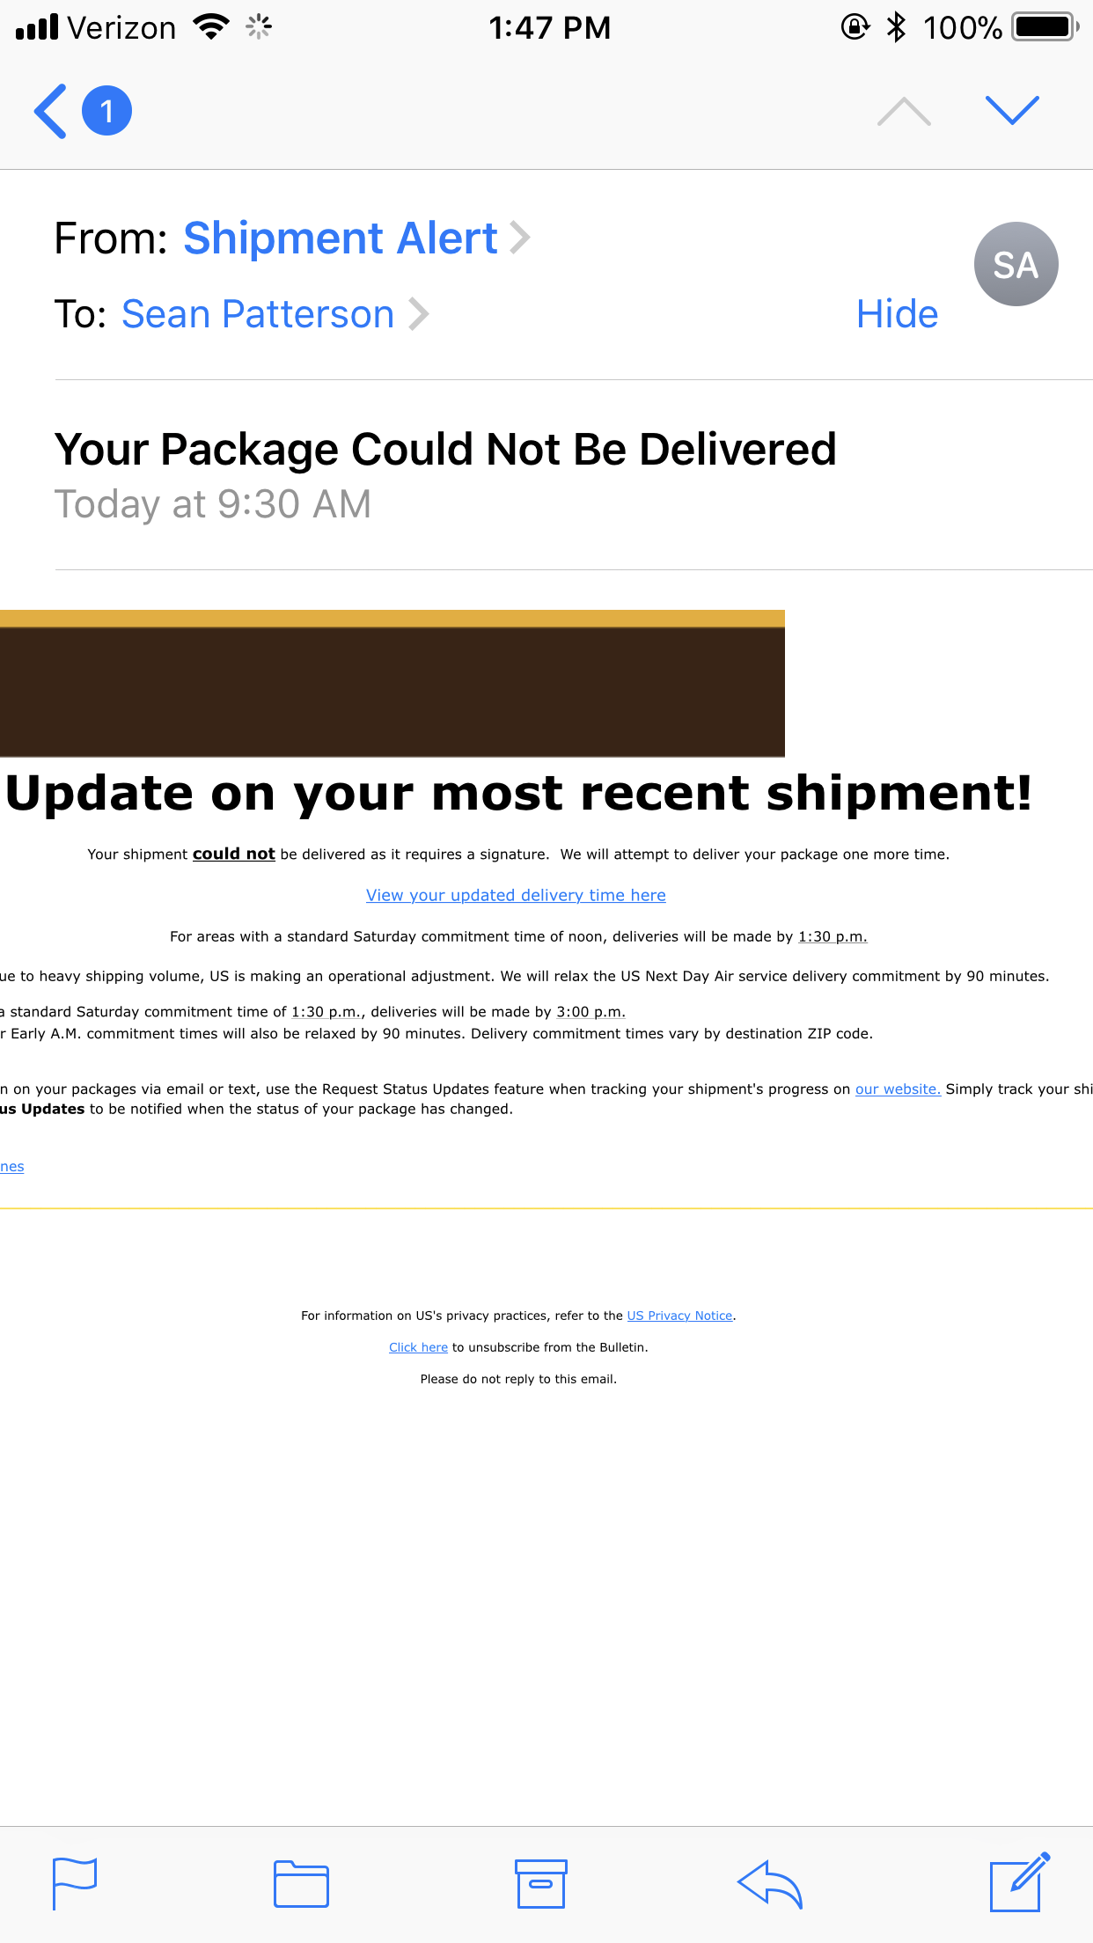
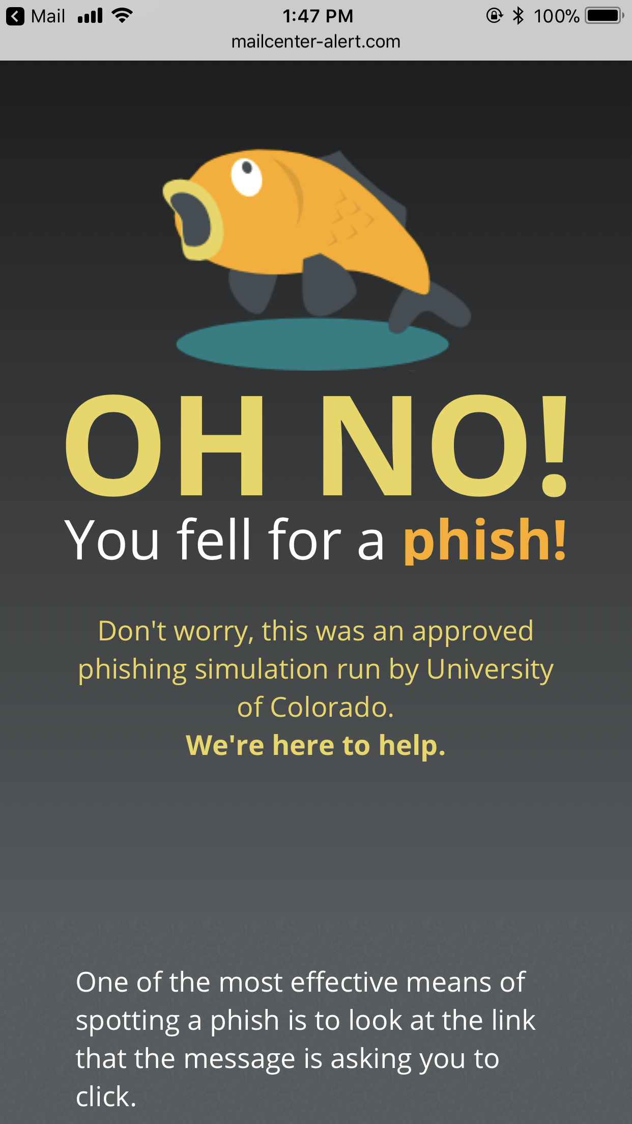
Relevance

Slide 4



Tools
Waffle is an automated project management tool powered by GitHub issues & pull requests.
Waffle.io -
Github -
GitHub is a Web-based Git version control repository hosting service.
GitKraken is a Git GUI client
GitKraken -
Notes:
Waffle.io and Github: Victoria
Serena: Git Kraken

Slide 5


Tools
Mobile app for group messaging
GroupMe -
Unified communications service that allows members to initiate and participate in video chats
Google Hangout -
Notes:
Victoria

Slide 6


Tools
HTML 5 -
Markup language used for structuring and presenting content on the Web.
Style sheet language used for describing the presentation of a document written in a markup language.
CSS 3 -

Slide 7


Tools
Open source relational database management system based on Structured Query Language
MySQL
Having changes between versions that make inserts different then reads is annoying and poorly documented in php7 mysql 5.5 integration manuals and sparsely documented online.
PhP
We did not use an automated testing software because it did not make sense for our project
Notes:
Peter

Slide 8



Tools
Sublime Text
Text Editor for code, markup, and prose
KompoZer
Web authoring system to facilitate easy initial layout of our webpages.
Open-source front-end web framework for designing websites and web applications. Has built in features to easily design using a grid layout
BootStrap
Notes:
Serena- Sublime and Bootstrap
KompoZer- Ziheng

Slide 9
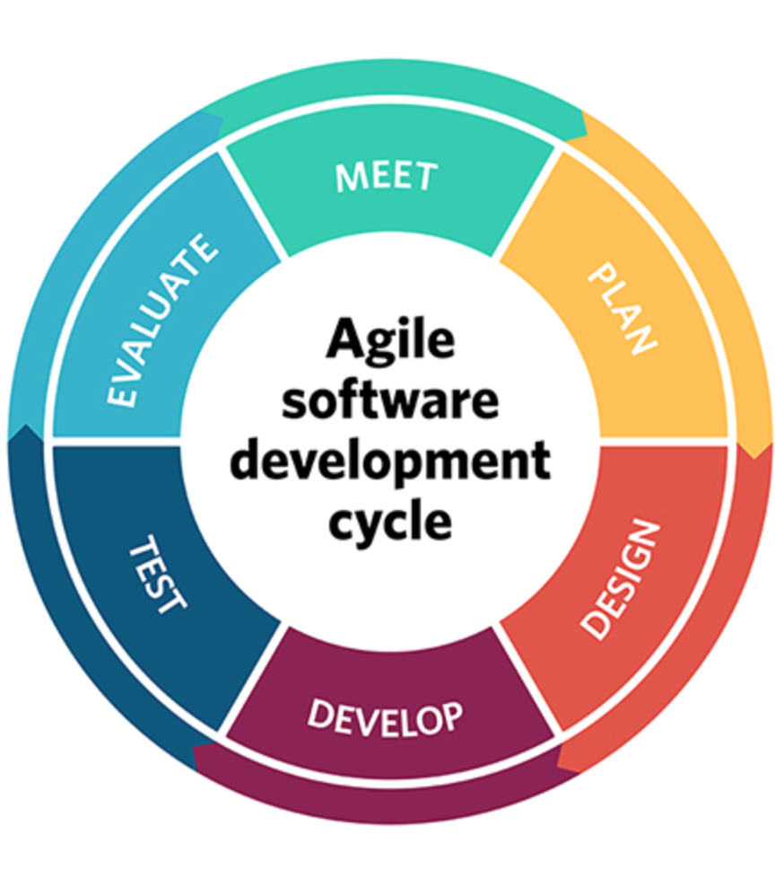
Methodologies
Agile
Iterative development, where requirements and solutions evolve through collaboration.
Notes:
Sean

Slide 10
Challenges
Biggest challenge was scope.
What can we do in our schedule?
Dropped MAC address saving so the address was always the same
Dropped the database holding styles, coordinating styles on multiple pages is time consuming
Dropped login required for the audit page
Emailing
Localhosts do not make it easy to send emails
Sending emails took 10 weeks to figure out, embedding graphic would be even longer

Slide 11
Challenges
Web Page design
Making it believable
Brand new skill
Coordinating Schedules
All busy college students
Couldn’t find a consistent time to meet
Notes:
Victoria -web design
Serena- Coordination

Slide 12
Demo
http://localhost/index.php
http://localhost/index1.php
http://localhost/audits.php

